Slide 1
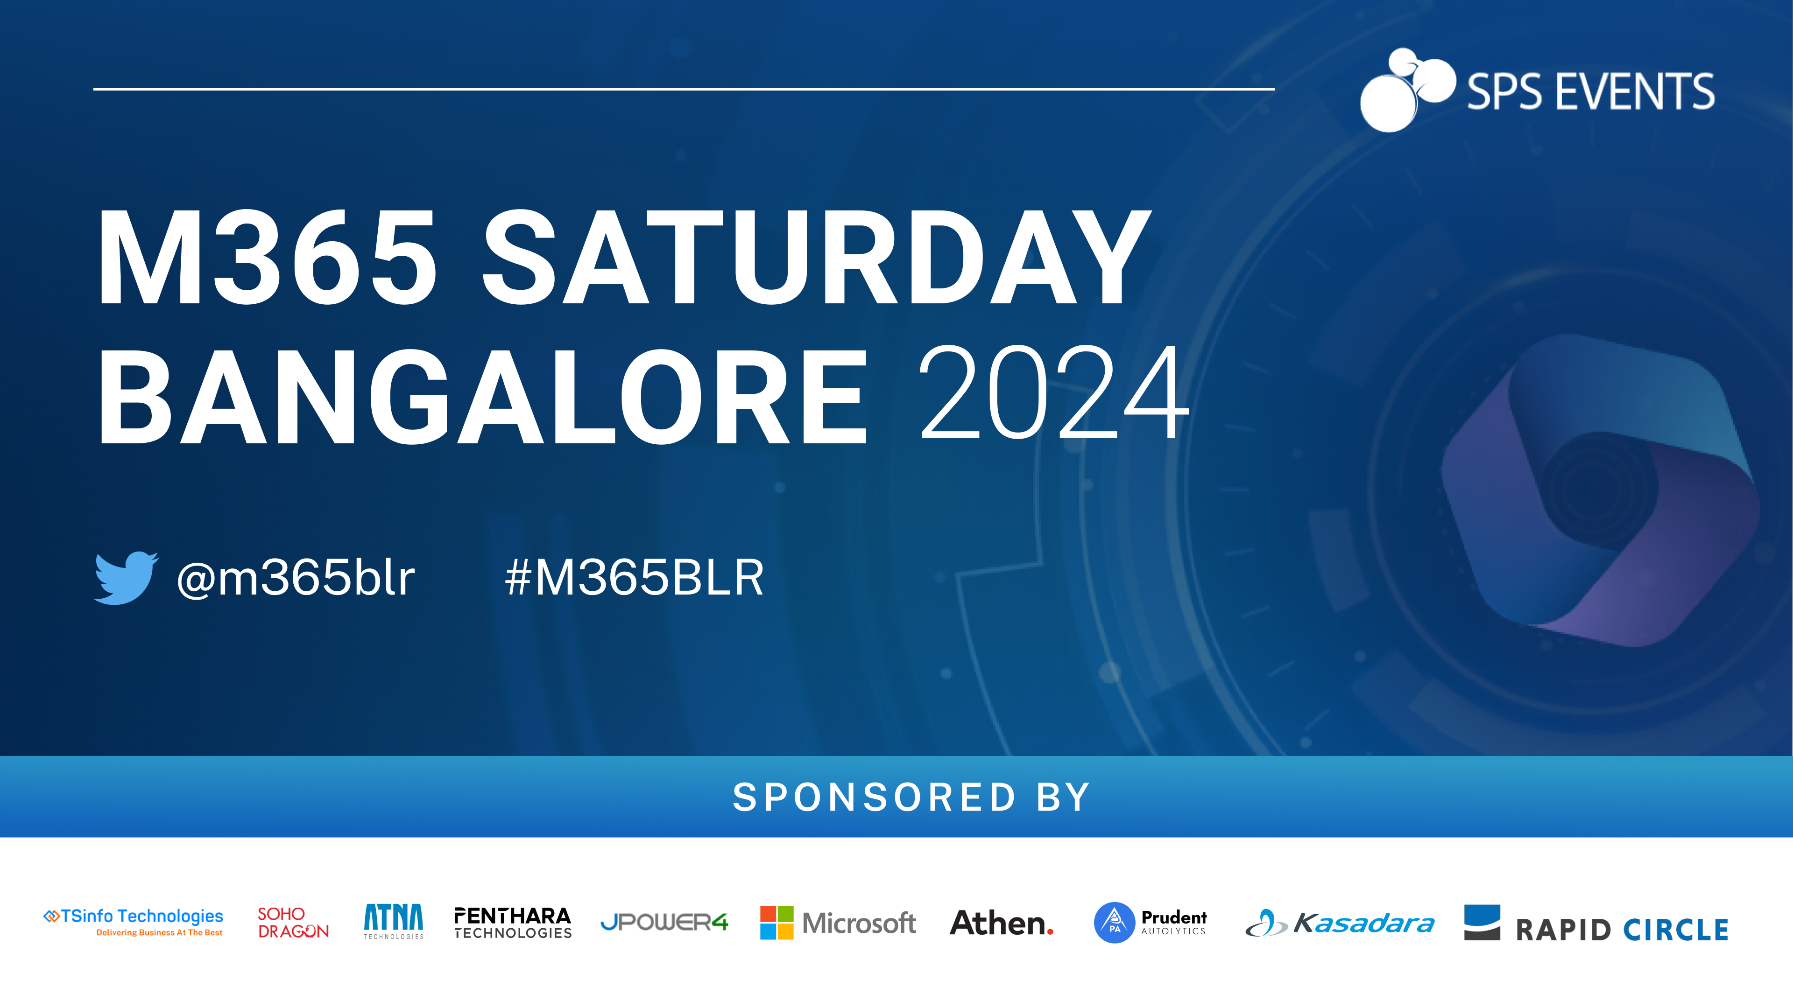
^{7th December 2024}

Slide 2

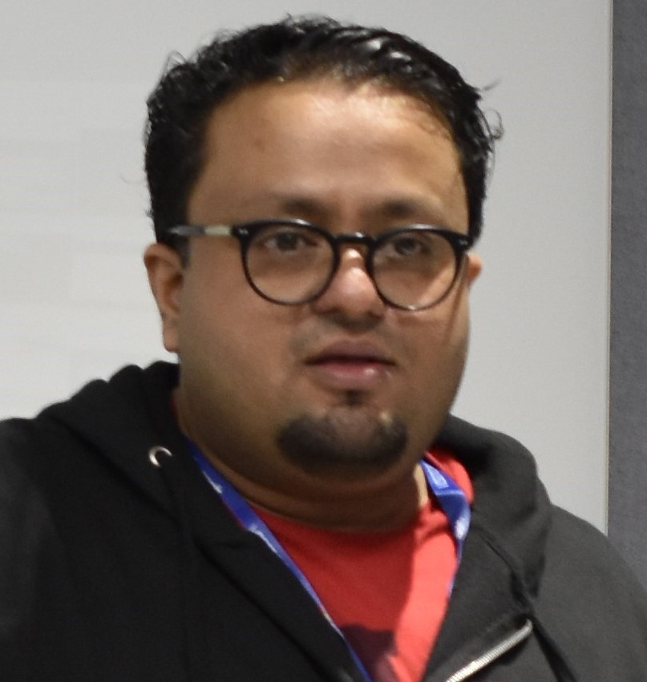
Track 2 - Session 5
SPEAKERS PANEL
Testing the Untestable using M365 Developer Proxy - Ensuring that your M365 Apps are resilient
02:45 PM– 03:30 PM IST
Arjun Menon
Microsoft MVP

Slide 3










A Big Thank You to all the Sponsors!

Slide 4
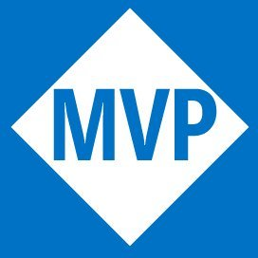




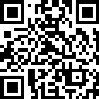


Who Am I
Microsoft MVP (M365 Development)
Co-maintainer – CLI for Microsoft 365
Core Team Member – Microsoft 365
& Power Platform Community (PnP)
Arjun Menon
/in/
arjunumenon
arjunumenon.com
This Photo by Unknown Author is licensed under CC BY
This Photo by Unknown Author is licensed under CC BY

Slide 5
What are we covering today 📋
What are resilient Apps 💪
Why test the untestable 🧪
Why building resilient apps is hard 🤯
How Dev Proxy makes life easier 🧘
Learn how to get started 🧑‍🏫
Audience: Developer, Tester, Administrator 🧑‍💻

Slide 6
What are resilient apps 🔒
An app is resilient if it
continues to carry out its mission in the face of adversity ▶️
Resilience assumes that adverse conditions will occur 🌩️
Resilience is not a tick box ✅

Slide 7
Cloud APIs Fail ❌
It’s not a matter of if, it’s when
How do you know what is going to happen?
How will your app recover? Will it recover?
How do you test for failures?

Slide 8
Testing Cloud APIs – Hard ⛓️‍💥
You don’t own the APIs
You can’t turn just turn behaviours on and off 🔘
Hard to get started
Nobody pays for testing 💵
Each API is different
Some return 429s, others 403s, some return several 429s

Slide 9

Dev Proxy to the rescue
Helps you build resilient apps on Microsoft 365
Improve robustness, performance and security
Test the untestable
Run against any app
Any platform and any tech stack
Supports any HTTP API
Presets for Microsoft Graph and SharePoint Online
Low investment (effort and time)
No code changes, no tedious setup
aka.ms/devproxy

Slide 10
Devproxy – How is helps you?
Improve robustness 💪
Random errors
What happens when APIs fail?
Latency
What happens when APIs are slow?
Throttling and Rate Limiting
What happens when APIs throttle?
Improve security 🔐
Detect minimum required permissions
Are you using the right scopes?
Detect over consented applications
Is your app obtaining more permissions than it needs?

Slide 11
Let us break and make 🧨 ➡️ 🏘️
See it in action!!

Slide 12
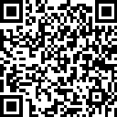
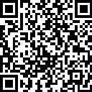
References 📜
Item | QR | Link
Demo Artefacts |  | https://a-um.me/blr2024-repo
References / Links |  | https://a-um.me/blr2024-references

Slide 13
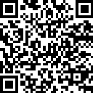
Feedback ❤️
https://a-um.me/blr2024-feedback

Slide 14

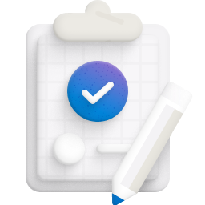
Q & A

Slide 15

Thank you

Slide 16
Thank you for attending this course
Here are some reminders
Let us know how we did
Give us your feedback
Feedback link will be share
Share about our event with #m365blr

Slide 17
A Big Thank You to all the Sponsors!

Slide 18

Next Session
SPEAKERS PANEL
Session Name
Session Time
Speaker Name
Designation

Slide 19
SLIDE TITLE

Slide 20
Session No.
SPEAKERS PANEL
Session Name
Session Time
Speaker Name
Designation

Slide 21
Session No.
SPEAKERS PANEL
Session Name
Speaker 1
Speaker 2
Session Time
Designation
Designation

